Slide 1
APUSH Review: Key Concept 1.1
Period 1: 1491 - 1607
Everything You Need To Know About Key Concept 1.1 To Succeed In APUSH
Updated for the 2015 revisions

Slide 2
The New Curriculum
Key Concept 1.1 “As native populations migrated and settled across the vast expanse of North America over time, they developed distinct and increasingly complex societies by adapting to and transforming their diverse environments.”
Page 25 of the Curriculum Framework
Big idea:
How did natives adapt to their environment?

Slide 3
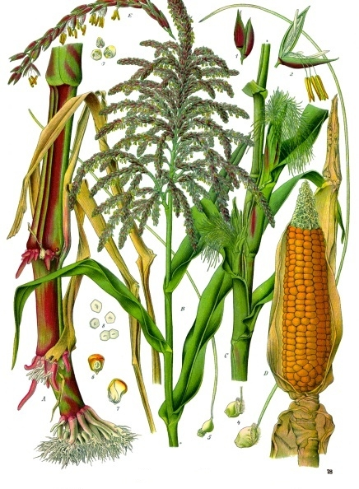
Key Concept 1.1, I
“Different native societies adapted to and transformed their environments through innovations in agriculture, resource use, and social structure.”
A) Impact of maize cultivation:
Very popular in the southwest
Societies developed vast irrigation systems (Pueblos in Rio Grande)
How did maize transform societies?
Less emphasis on hunting and gathering
Increase in population
Establishment of permanent villages with socially diverse societies
Tenochtitlan – 250,000 people, social classes

Slide 4
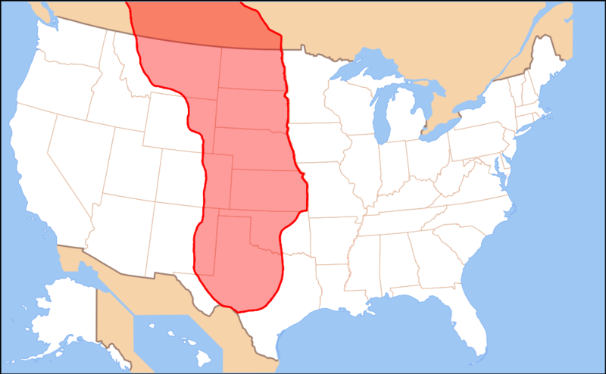
B) Great Plains and Great Basin
Most natives lived off of hunting and gathering
Lack of natural resources
Large, flat area that was arid (dry) – Basin
Grassland- Plains
With the introduction of the horse, life on the Great Plains was drastically altered
Bison hunting became much easier
Natives with horses became stronger militarily
Natives in the Great Basin hunted bison and sheep
Like natives on the Great Plains, horses helped natives become more powerful

Slide 5
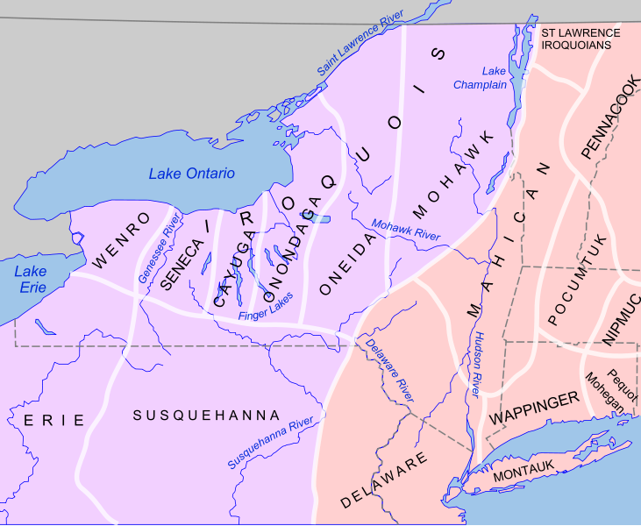
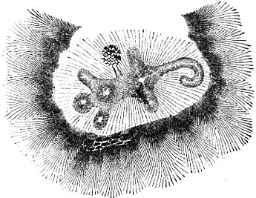
C) Northeast, Mississippi River Valley, and Atlantic Seaboard
Many societies were a mix of hunting and gathering, and agriculture and developed permanent villages
Iroquois (Present day NY and PA):
Adapted to their environment:
Burned forests to hunt and grow crops
Villages were built around maize
Iroquois were a matriarchal society:
Power was based on female authority
Women were instrumental in councils and decision-making
Women would tend to crops and oversaw community affairs while men hunted
Cahokia Indians – near present-day St. Louis (around 30,000 people in 1200)
Built giant mounds
Largest settled community until NY and Philadelphia in 1800

Slide 6
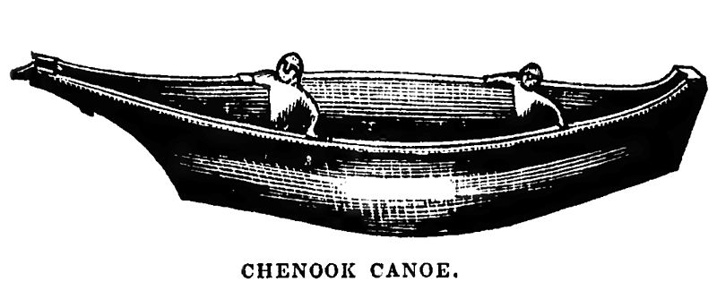
D) Northwest And Present-Day California
Roughly 300,000 natives lived in California prior to the arrival of Europeans
Most of these societies were based on hunting, gathering, and foraging
Gather nuts, fish, and hunted
Societies tended to be ruled by wealthy families
Chinooks
Advocated warrior traditions
Used advanced fighting techniques
Lived in longhouses which could house many families

Slide 7
Test Tips
Multiple-Choice and Short Answer Questions:
Map of different areas of North America: How did natives adapt to their environment?
Essay Questions:
Not likely since it is from period 1

Slide 8
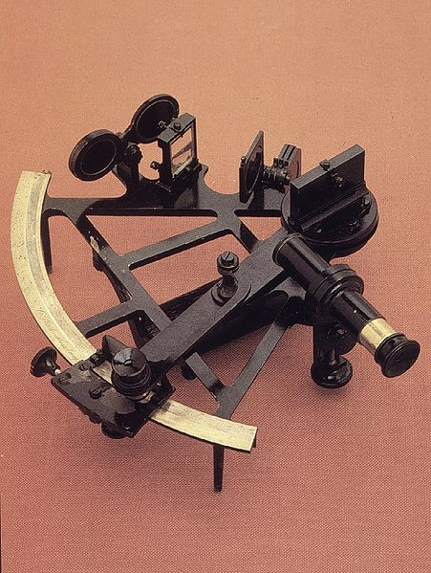
See You Back Here For Key Concept 1.2!
Good luck in May
Please subscribe and share
Check out APUSHReview.com for many more resources
Practice Multiple-Choice Questions

